Slide 1
Use of mathematical descriptors and robust statistical methods in predicting mutagenicity of congeneric and diverse sets of chemicals
Subhash C. Basak , University of MN Duluth (UMD) , USA
Subhabrata Majumdar, U of Florida, Gainesville, USA
Gregory D. Grunwald, UMD/ NRRI, Duluth, MN, USA
Claudiu N. Lungu and Mircea V. Diudea, Babes-Bolyai University, Cluj, Romania

Slide 2
Experimental vs in silico structural approach
Experimental Determination
of Properties
C
R
Generation of Descriptors
Estimation of Properties
D
C = a set of chemicals
R = the set of real numbers
D = a set of structural descriptors
P = f (S)

Slide 3
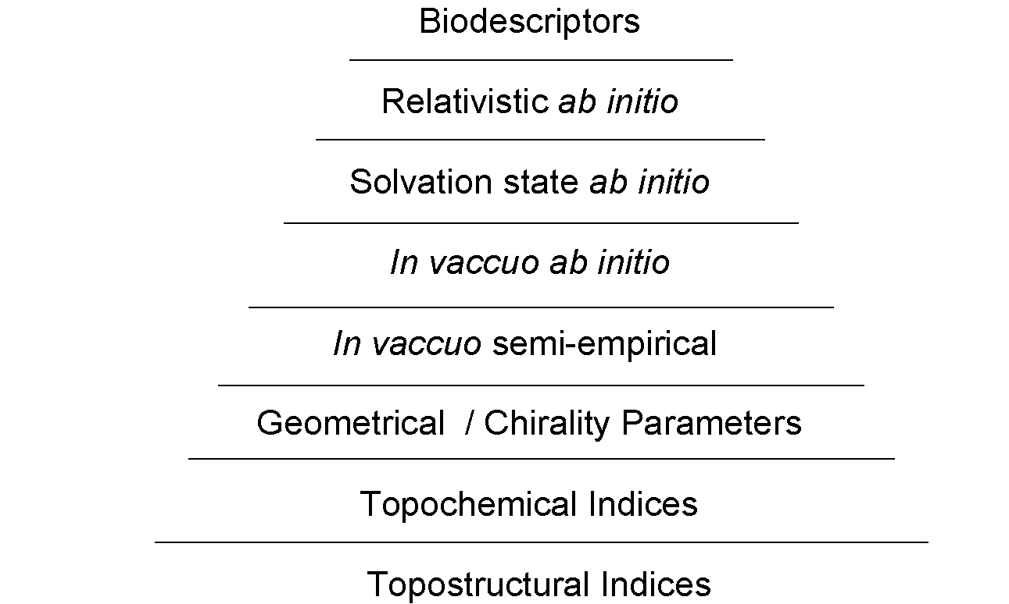
Hierarchical QSAR
Complexity
Cost

Slide 4
QSAR
Good quality data
Adequately large databases
Relevant descriptors
Proper statistical methods

Slide 5
MUTAGENICITY

Slide 6
Mutagen data sets
95 Aromatic and heteroaromatic amines
Ames’ test- TA 100
Originally collated by Debnath et al (Hansch group)
508 structurally diverse chemicals
Ames test- TA98
256 mutagens and 252 non-mutagens.

Slide 7
Chemical classes of samples in the 508 compound
Aliphatic alkanes, alkenes, alkynes 124
Monocyclic compounds 260
Monocyclic carbocycles 186
Monocyclic heterocycles 74
Polycyclic compounds 192
Polycyclic carbocycles 119
Polycyclic heterocycles 73
Nitro compounds 47
Nitroso compounds 30
Alkyl halides 55
Alcohols, thiols 93

Slide 8
Chemical classes of samples in the 508 compound
Ethers, sulfides 38
Ketones, ketenes, imines, quinones 39
Carboxylic acids, peroxy acids 34
Esters, lactones 34
Amides, imides, lactams 36
Carbamates, ureas, thioureas, guanidines 41
Amines, hydroxylamines 143
Hydrazines, hydrazides, hydrazones, traizines55
Oxygenated sulfur and phosphorus 53
Epoxides, peroxides, aziridines 25

Slide 9
Software used for descriptor calculation: U of MN team
POLLY v2.3, S. C. Basak, D. K. Harriss and V. R. Magnuson, Copyright of the University of Minnesota, 1982/ 1988.
MolconnZ v4.05, Quincy, MA: Hall Ass. Consult., 2003.
Triplet, S. C. Basak, G. Grunwald and A. Balaban, " Copyright of the Regents of the University of Minnesota, 1993.
MOPAC- Semiempirical QC descriptors

Slide 10
Software used for descriptor calculation: Diudea et al, Cluj Romania
Schrodinger- Descriptors calculated by Diudea et al, Cluj, Romania.
TopoCluj- in-house software TopoCluj of Diudea group, at Cluj, Romania

Slide 11
Descriptors- U of MN team
95 Aromatic amine
275 descriptors were calculated for this paper.
508 structurally diverse chemicals
508 chemical set, 307 descriptors were

Slide 12
Descriptors- Cluj team
95 Aromatic amine
185 descriptors were calculated
508 structurally diverse chemicals
201 descriptors were calculated

Slide 13
Dimension reduction and variable selection
You will never reach your destination if you stop and throw stones at every dog that barks.
Winston Churchill

Slide 14
Intrinsic dimensionality
The goal is to find out lower dimensional structures in the very high-dimensional descriptor space that are chemically relevant.
Two approaches are possible: (a) Variable selection: LASSO, Inter-related two-way clustering (Majumdar et al, 2013); (b) Dimension reduction: PCA, robust PCA, envelope methods (Basak and Majumdar, 2015; Majumdar and Basak, 2016).

Slide 15
Intrinsic dimensionality: example
Variable selection: the dataset has 500 descriptor, of which 10 get selected in the QSAR model based on lasso. This means the predictor effects influencing chemical activity lie on a 10-dimensional subspace according to the model.
Dimension reduction: PCA is done on the descriptor set, and top 10 PCs are used in regression to build a QSAR model. Here also the intrinsic dimensionality is 10. But the new variables are combinations of original descriptors.

Slide 16
PCA results with UMN descriptors only: 95 amines
PC1 | PC2 | PC3 | PC4
SHBint₃ (0.64) | NHBint₇ (0.79) | NHBint₈ (0.53) | ⁷χ_{P} (0.66)
¹χ (0.28) | SHBint₃ (0.31) | NHBint₇ (0.43) | SssCH2 (-0.39)
⁰χ (0.28) | NHBint₉ (-0.26) | NHBint₉ (0.39) | nelem (0.29)
CIC₆ (0.24) | ⁷χ_{P} (0.19) | SsssCH (0.25) | SsssCH (0.23)
NHBint₇ (-0.23) | NHBint₈ (-0.18) | ⁷χ_{P} (0.21) | NHBint₇ (-0.21)
NHBint₉ (-0.21) | SsssCH (0.14) | NHBint₁₀ (0.16) | SHBint₃ (-0.19)
CIC₅ (0.16) | SHBint₄ (0.14) | ¹χ (0.16) | kp₃ (-0.18)
Gmax (0.14) | NHBint₁₀ (-0.12) | ⁰χ (0.15) | NHBint₈ (-0.12)
ASV₄ (0.1) | phia (-0.1) | SHBint₄ (-0.14) | SHBint₄ (0.11)
ASV₃ (0.1) | kp₃ (-0.09) | CIC₆ (0.11) | ASV₁ (-0.09)

Slide 17
PCA results with UMN descriptors only: 508 diverse
PC1 | PC2 | PC3 | PC4
ΔHf (-0.85) | ΔHf (-0.50) | E_{HOMO} (-0.71) | E_{HOMO} (-0.67)
P₁₀ (-0.17) | P₉ (0.22) | E_{LUMO} (0.51) | E_{LUMO} (0.57)
P₉ (-0.16) | P₁₀ (0.22) | E_{LUMO+1} (0.35) | E_{LUMO+1} (0.37)
P₈ (-0.15) | P₈ (0.21) | E_{HOMO-1} (0.21) | µ (-0.13)
P₇ (-0.13) | P₇ (0.19) | µ (-0.14) | P₁₀ (0.12)
P₆ (-0.11) | P₆ (0.15) | P₁₀ (0.1) | P₉ (0.1)
E_{LUMO} (0.11) | E_{LUMO} (-0.13) | P₉ (0.09) | P₈ (0.08)
P₅ (-0.09) | P₅ (0.13) | P₈ (0.04) | E_{HOMO-1} (-0.06)
E_{LUMO+1} (-0.08) | SPC₆ (0.13) | CIC₄ (0.04) | CIC₂ (0.04)
P₄ (-0.07) | AZS₂ (0.13) | ⁵χ^{b} (0.04) | CIC₃ (0.04)

Slide 18
PCA results with Combined set of descriptors: 95 amines
PC1 (12.5%) | PC2 (10.3%) | PC3 (7.1%) | PC4 (6.9%)
E_ele (0.69) | E_ele (-0.42) | E_ele (-0.35) | E_vdw (-0.73)
vsurf_EWmin1 (-0.43) | vsurf_EWmin1 (-0.27) | vsurf_EWmin1 (-0.33) | E_nb (-0.48)
vsurf_EWmin2 (-0.4) | vsurf_EWmin2 (-0.25) | E_vdw (-0.31) | E_ele (0.34)
vsurf_EWmin3 (-0.3) | vsurf_DW13 (-0.21) | vsurf_EWmin2 (-0.31) | vsurf_EWmin1 (0.19)
vsurf_DW13 (-0.17) | vsurf_EWmin3 (-0.18) | E_nb (-0.27) | vsurf_EWmin2 (0.18)
E_nb (0.11) | E_nb (-0.17) | vsurf_EWmin3 (-0.23) | vsurf_DW13 (-0.14)
vsurf_HB6 (0.08) | E_vdw (-0.17) | vsurf_DW13 (0.21) | vsurf_EWmin3 (0.13)
vsurf_W6 (0.08) | DN2Z2 (0.16) | DN2Z2 (-0.16) | GCUT_SlogP_0 (0.06)
vsurf_HL2 (0.06) | SlogP_VSA9 (0.13) | GCUT_SMR_0 (–0.11) | GCUT_SMR_0 (0.06)
vsurf_CW6 (0.06) | ASZ2 (0.12) | ASZ2 (-0.1) | DN2Z2 (0.04)
Bold = Triplet descriptors

Slide 19
PCA results with Combined set of descriptors: 508 diverse
PC1 (15%) | PC2 (14.1%) | PC3 (12%) | PC4 (9.3%)
E_tor (0.96) | vsurf_DW23 (0.95) | density (-0.93) | GCUT_SlogP_0 (0.96)
vsurf_DW23 (-0.25) | E_tor (0.23) | GCUT_SlogP_0 (-0.19) | density (-0.19)
GCUT_SlogP_0 (0.06) | GCUT_SlogP_0 (0.15) | vsurf_ID2 (0.12) | vsurf_DW23 (-0.14)
vsurf_ID3 (-0.04) | density (-0.07) | vsurf_ID3 (0.12) | E_tor (-0.09)
vsurf_ID4 (-0.04) | vsurf_ID2 (-0.06) | vsurf_ID4 (0.11) | vsurf_CP (0.05)
vsurf_ID2 (-0.04) | vsurf_ID1 (-0.05) | vsurf_ID1 (0.1) | vsurf_ID2 (0.04)
vsurf_ID6 (-0.03) | vsurf_ID3 (-0.05) | vsurf_IW1 (0.1) | vsurf_ID4 (0.02)
vsurf_ID1 (-0.03) | vsurf_ID4 (-0.04) | vsurf_ID5 (0.09) | vsurf_ID3 (0.02)
vsurf_ID5 (-0.03) | vsurf_CW4 (-0.04) | BCUT_SMR_2 (-0.09) | vsurf_ID1 (0.02)
vsurf_ID7 (-0.03) | vsurf_ID6 (-0.03) | vsurf_ID6 (0.07) | vsurf_ID7 (0.02)

Slide 20
PCA- Interpretation

Slide 21
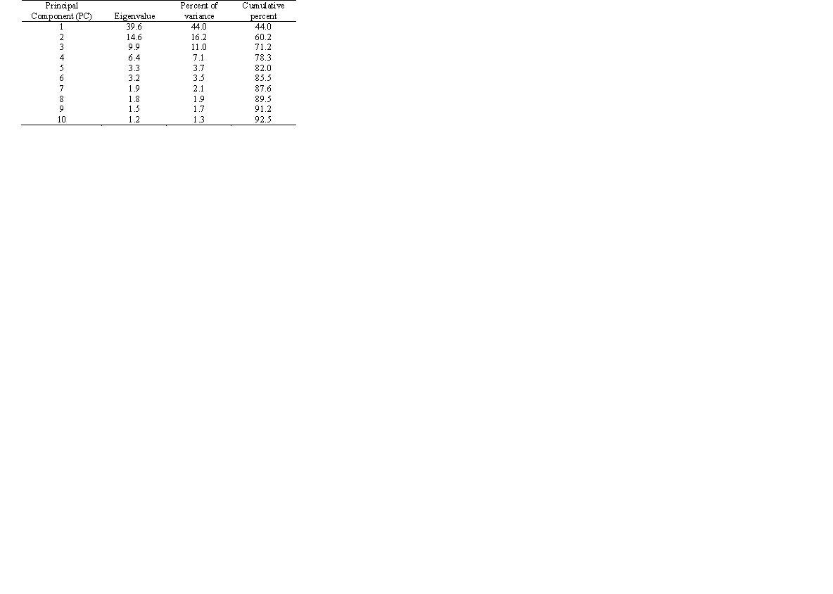
Data Reduction via Principal Components Analysis
3,692 chemicals; 90 diverse TIs
(Basak, Magnusson, Niemi, Regal, and Veith, 1987)
10 PCs with Eigenvalues greater than 1
First 10 PCs explain 92% of the variance within the data
First 4 PCs account for 78% of the variance within the data

Slide 22
PC1 Size
PC2 Symmetry
PC3 Branching
PC4 Cyclicity
S.C. Basak, V.R. Magnuson, G.J. Niemi, R.R. Regal Discrete Applied Mathematics 19 (1988) 17-44

Slide 23
PC interpretation: Combined set of descriptors
Subho, let us discuss this today
The energetic variable E_ele has very high loadings across all PCs (Highest for PC1 to 3, third highest for PC4), advising that the activity of 95 amines is possibly guided by an energetic dependent process, i.e. interaction with a potential target
The top 4 PCs have highest loadings for the following relevant variables: E_tor (0.96), vsurf_DW23 (0.95), density (-0.93), GCUT_SlogP_0 (0.96), which are part of the so-called ‘absorption, distribution, metabolism, and excretion’ (ADME) features.

Slide 24
Model building methods
Principal component regression (PCR), partial least squares (PLS)- preferred when one wants to explore lower dimensional subspaces in QSAR data
Least absolute shrinkage and selection operator (LASSO), smoothly clipped absolute deviation (SCAD)- preferred when one wants sparse models, i.e. the effect of some predictors are set to zero.
Random forest (RF) and gradient boosting (GBM)- machine learning methods that typically perform well in prediction, so are preferred if predictive accuracy of chemical activities is the priority.

Slide 25
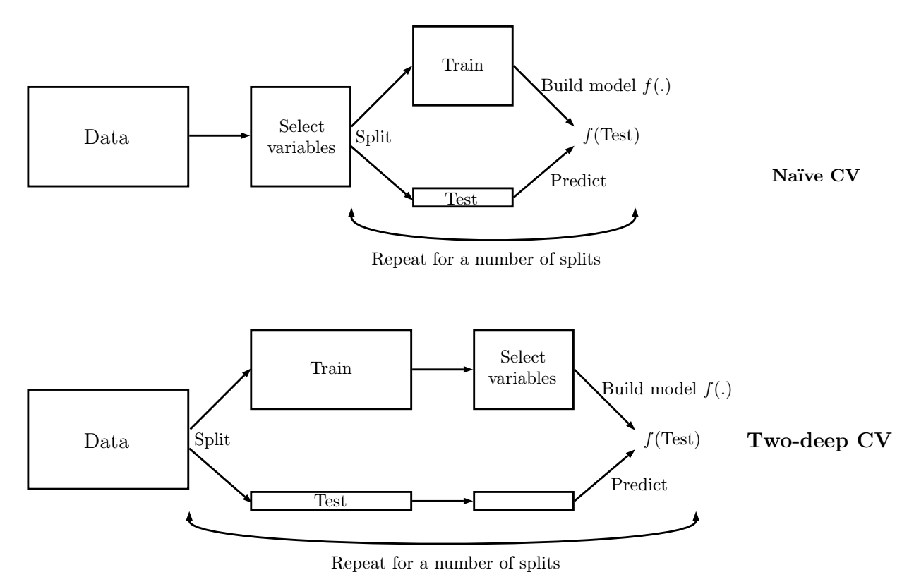
Two deep cross validation

Slide 26
Issues: two-deep cross-validation
Cross validation is important to test actual predictive capability of the model.
Care needs to be taken when combining dimension reduction with k-fold or leave-one-out cross validation.
Doing dimension reduction first and then performing cross-validation through training-test splits uses information from holdout compounds in the first step. It inflates the resulting q² value (naïve CV)
The right approach is to perform dimension reduction separately for each training-test split (Two-deep CV)

Slide 27
Beware of external validation!
Following the investigation of Golbraikh and Tropsha, 2002, external validation has been the norm in QSAR for the past few years.
However external validation with random splits is too unstable for high-dimensional low-sample size datasets (Majumdar and Basak, 2018).
Repeated external validation, i.e. repeat for many random splits then take average, is recommended in such cases.

Slide 28
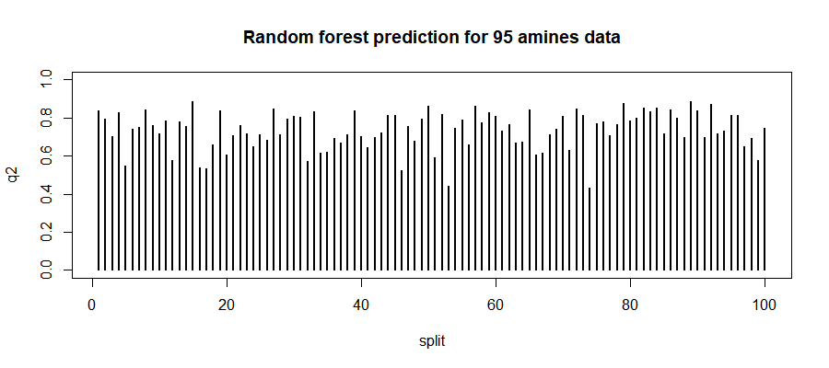
Beware of external validation! - example
Plot of q² values for all the 100 splits

Slide 29
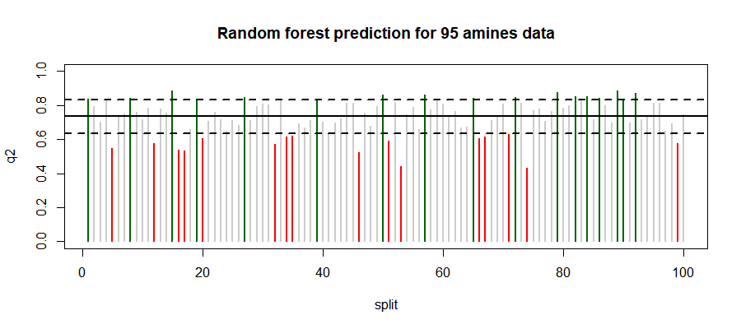
Beware of external validation! - example
Some values are simply too low (red) or too high (green), so depending on the split we can easily over or underestimate the predictive capability of the model.
In comparison, the mean (black) is in the middle, and adding standard deviation error bars (black dotted) gives an estimate of uncertainty.

Slide 30
Beware of external validation! - example
Moral of the story: It makes much more sense to use an average q² over multiple splits and report standard deviation, instead of splitting the data randomly and calculating q².

Slide 31
Repeated external validation results of UMN & Cluj Descriptor mutagenicity QSARs
Method | Descriptor set used (Area Under Curve)
 | Combined | Basak lab | Diudea lab
PCR | 0.59 (0.055) | 0.78 (0.038) | 0.58 (0.057)
PLS | 0.86 (0.035) | 0.85 (0.033) | 0.79 (0.038)
Lasso | 0.72 (0.048) | 0.75 (0.045) | 0.63 (0.06)
SCAD | 0.57 (0.061) | 0.58 (0.059) | 0.62 (0.063)
RF | 0.81 (0.036) | 0.80 (0.042) | 0.79 (0.040)
GBM | 0.80 (0.04) | 0.82 (0.04) | 0.75 (0.042)
508 diverse
Method | Descriptor set used (squared prediction error)
 | Combined | Basak lab | Diudea lab
PCR | 29.11 (13.79) | 57.08 (93.829) | 76.02 (24.72)
PLS | 18.86 (6.03) | 19.86 (7.464) | 75.70 (24.689)
Lasso | 26.85 (9.049) | 28.72 (8.825) | 72.75 (17.998)
SCAD | 25.81 (8.962) | 31.77 (21.442) | 74.94 (18.322)
RF | 17.25 (6.498) | 18.98 (6.587) | 84.59 (21.735)
GBM | 14.79 (5.836) | 18.03 (6.296) | 74.78 (17.426)
95 amine

Slide 32
References
Adapting Interrelated Two-Way Clustering Method for Quantitative Structure-Activity Relationship (QSAR) Modeling of Mutagenicity/Non-Mutagenicity of a Diverse Set of Chemicals. Majumdar, S., Basak, S. C. and Grunwald, G. D. Curr. Comput. Aided Drug Des., 2013, 9, 463-471.
Prediction of Mutagenicity of Chemicals from Their Calculated Molecular Descriptors: A Case Study with Structurally Homogeneous versus Diverse Datasets. Basak, S. C. and Majumdar, S. Curr. Comput. Aided Drug Des., 2015, 11, 117-123.
Exploring intrinsic dimensionality of chemical spaces for robust QSAR model development: A comparison of several statistical approaches. Majumdar, S. and Basak, S. C. Curr. Comput. Aided Drug Des. , 2016, 12, 294-301.
Hawkins, D.M.; Basak, S.C.; Shi, X. QSAR with few compounds and many features. J. Chem. Inf. Comput. Sci., 2001, 41, 663-670.
Yang, Y. Consistency of cross validation for comparing regression procedures. Ann. Statist., 2007, 35, 2450-2473.
S. Majumdar and S. C. Basak. Beware of Naïve q2, use True q2: Some Comments on QSAR Model Building and Cross Validation, Curr. Comput.-Aided Drug Des., 2018, 14, 5-6.
A. Golbraikh and A. Tropsha, Beware of q2!, J. Mol. Graph. Model., 2002, 20, 269-276.
S. Majumdar and S. C. Basak, Beware of external validation! – A Comparative Study of Several Validation Techniques used in QSAR Modelling, Curr. Comput.-Aided Drug Des., 2018, 14, in press.

Slide 33
Quo Vadimus?

Slide 34
Biodescriptors

Slide 35
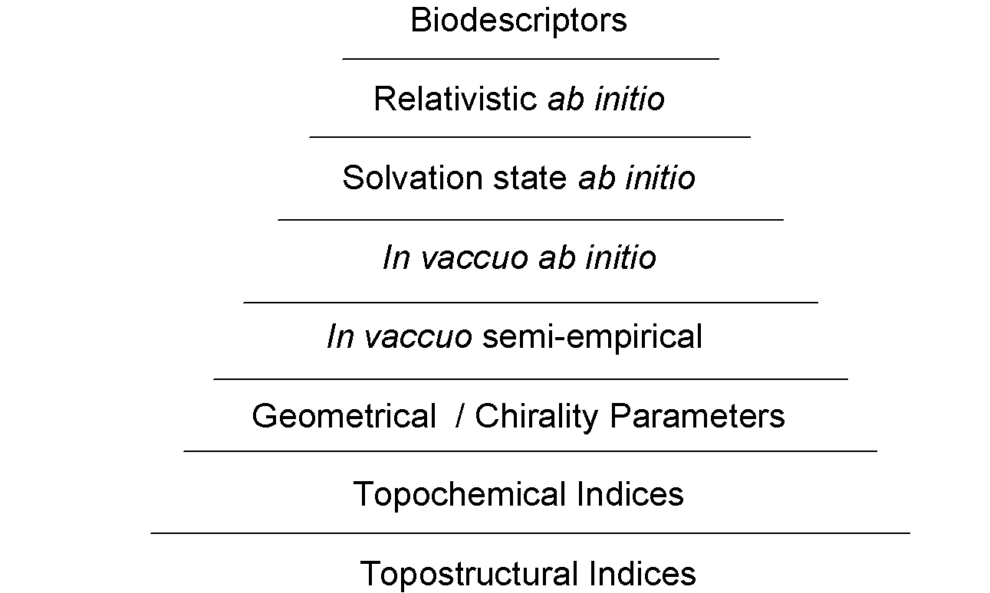
Hierarchical QSAR
Complexity
Cost

Slide 36
Biodescriptors
Descriptors for biological systems
DNA descriptors
Proteomics descriptors

Slide 37
Genetic Alibi
“If your chromosomes are XYY
And you are a naughty, naughty guy
Your crimes the judge won’t even try
Because you have a legal reason why
He will raise his hands and gently sigh
I guess for this you get a buy.
……………………………..”

Slide 38
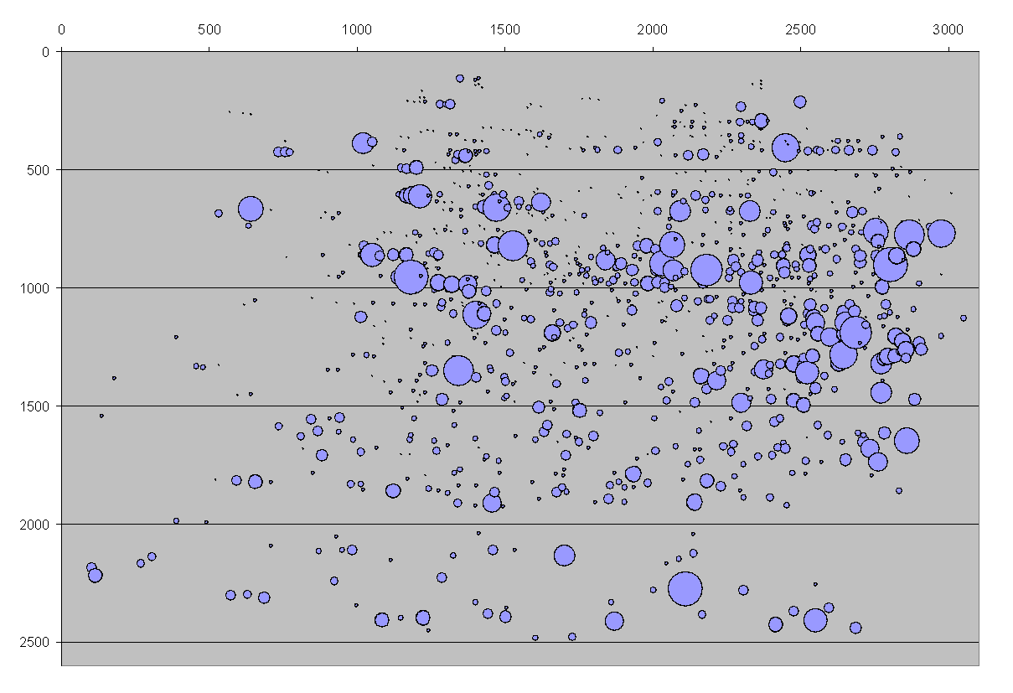
Location and abundance of proteins in the 2-D gel
Randic, Witzmann, Vracko, and Basak, Med. Chem. Res., 10, 456-479, 2001.

Slide 39
Different approaches to Proteomics based biodescriptor development
Graphs/ matrices associated with proteomics maps (Randic, Basak et al)
Information theoretic biodescriptors (Basak et al)
Biodescriptors from spectrum-like representations of proteomics maps (Vracko, Basak et al)
Statistical approaches to discover critical protein biomarkers (Hawkins, Basak et al)

Slide 40
Critical protein biomarkers (Hawkins, Basak et al)
Complex biosignature
Or
Individual biomarkers?

Slide 41
Halocarbon Exposures (EC20)
Rat Hepatocyte Exposures (in vitro):
Control + 14 halomethanes/haloethanes/
ethylenes
Includes Cl and Br
n = 2 or 3
Samples solubilized
~ 175 ug separated on 2DE
CBBG250 stain
Image analysis (gel matching) with normalization
Quantitative data exported via excel

Slide 42
Six Toxicity Assays
MTT (Mitochondrial function)
LDH (Membrane integrity)
SH Total cellular thiols
LP Lipid peroxidation
ROS Reactive oxygen species
CAT Catalase activity
Cellular viability

Slide 43
Ridge Regression Models
Sets of independent variables for the prediction of cellular toxicity due to halocarbon exposure:
TI Topological Indices
MIC Map Information Content
SLD Spectrum-like Descriptors
SOS Subset of spots
Chemodescriptors
Biodescriptors

Slide 44
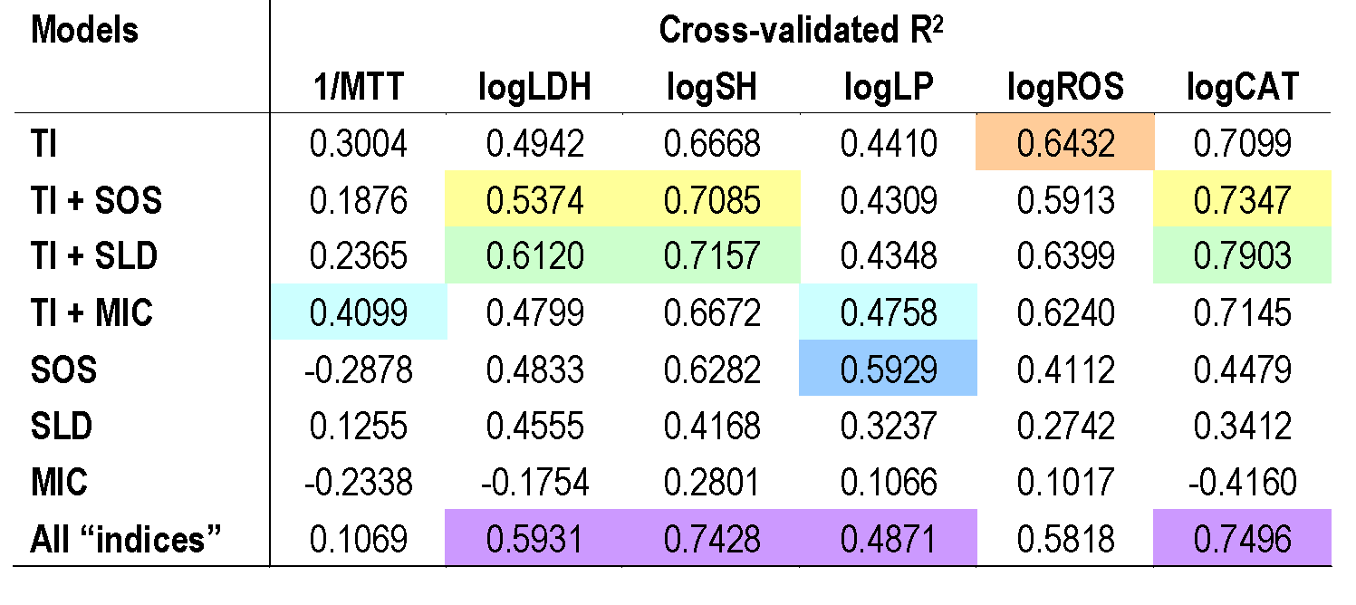
Ridge Regression Results

Slide 45
Combining chemodescriptors and biodescriptors in quantitative structure-activity relationship modeling, Hawkins, D. M.; Basak, S. C.; Kraker, J. J.; Geiss, K. T.; Witzmann, F. A. J. Chem. Inf. Model., 46, 9–16 (2006).

Slide 46
Review article
“Mathematical biodescriptors of proteomics maps: Background and applications “ SC Basak and BD Gute, Current Opinions in Drug Discovery and Development, 2008, 11(3) pp. 320-326.

Slide 47
Mathematical Nanotoxicoproteomics Team: Marjan Vracko, Fran Witzmann & Subhash Basak

Slide 48
Proteomic data to be analyzed….
We analyzed the proteomics of Caco cells unexposed (control) and exposed for:
multi-walled carbon nanotubes (MWCNT) 3 h 10 μg,
multi-walled carbon nanotubes (MWCNT) 3 h 100 μg,
multi-walled carbon nanotubes (MWCNT) 24 h 10 μg,
multi-walled carbon nanotubes (MWCNT) 24 h 100 μg,
TiO₂ nanobelts (TiO₂-NB) 3 h 10 μg,
TiO₂ nanobelts (TiO₂-NB) 3 h 100 μg ,
TiO₂ nanobelts (TiO₂-NB) 24 h 10 μg,
TiO₂ nanobelts (TiO₂-NB) 24 h 100 μg.
In each measurement, 3000 to 3300 proteins were identified.

Slide 49
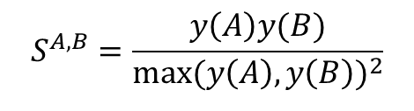
Similarity index as a measure of ratio between untreated and treated cells…
The ratios between protein abundances of control and treated samples is expressed with the index.
We denote two measurements by a (control) and b (treated). The similarity index is defined as:
Here, N is the number of proteins considered, and are intensities (abundances) of i-th protein and the maximal value of both intensities. Some of its properties are straightforward.
1. If protein abundances do not change the similarity index is equal 1.
2. s ^{A,B} = s ^{B,A}.
3. If all reported proteins are different the similarity index is zero.
4. It measures the changes in abundance and each individual spot and it is not sensitive on sign of difference.

Slide 50
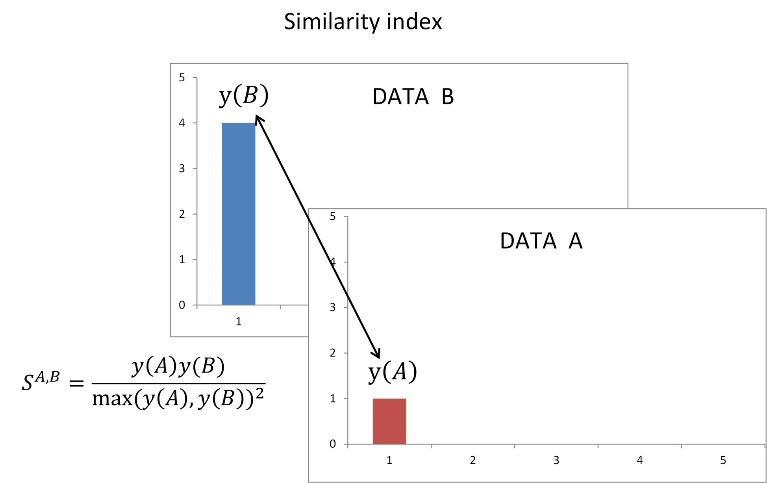

Slide 51
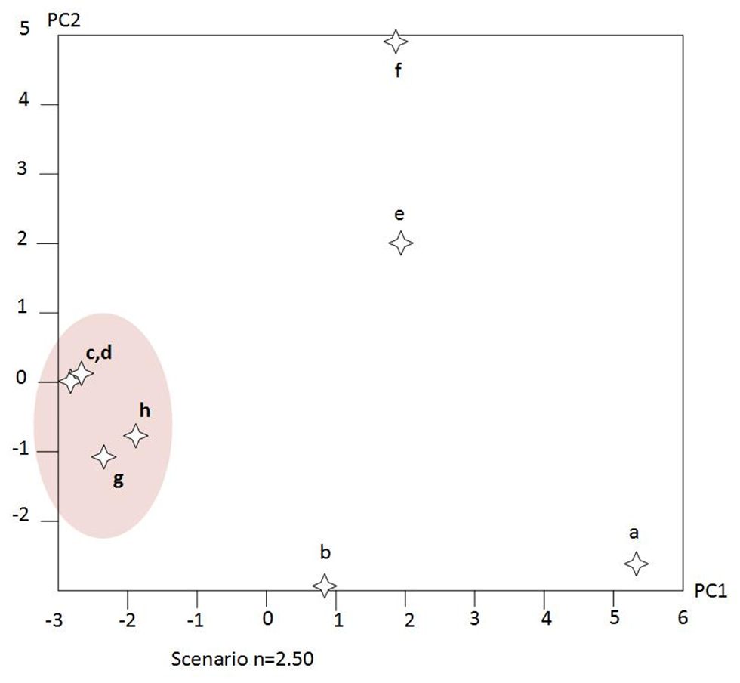
PCA: Short term and long term TiO2 and MWCNT treatment of Caco cells: Vracko, Basak & Witzmann, CCADD, in press.

Slide 52
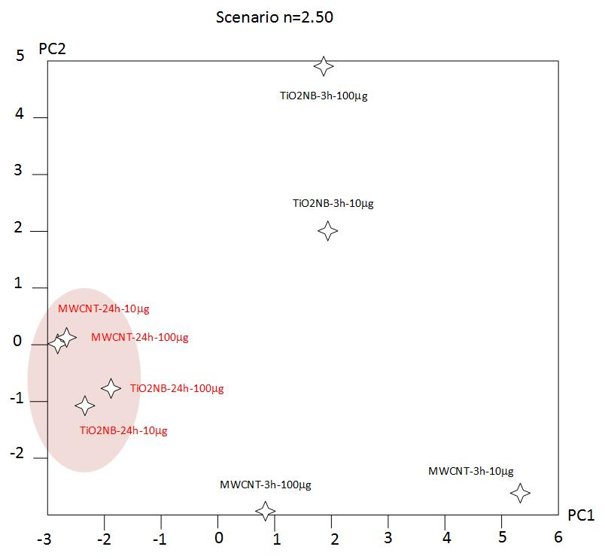
PCA: Short term and long term TiO2 and MWCNT treatment of Caco/HT29-MTX cells Vracko, Basak & Witzmann, CCADD, in press.
Caco/HT29-MTX

Slide 53
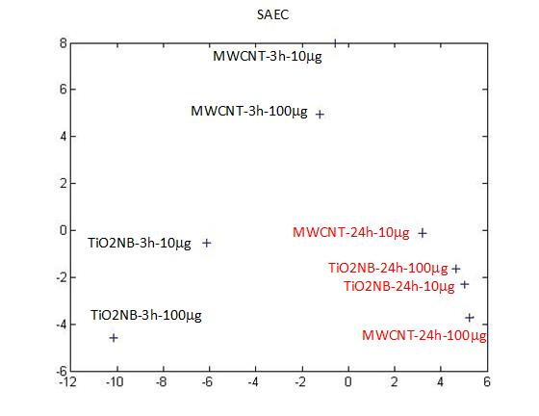
PCA: Short term and long term TiO2 and MWCNT treatment of SAEC

Slide 54
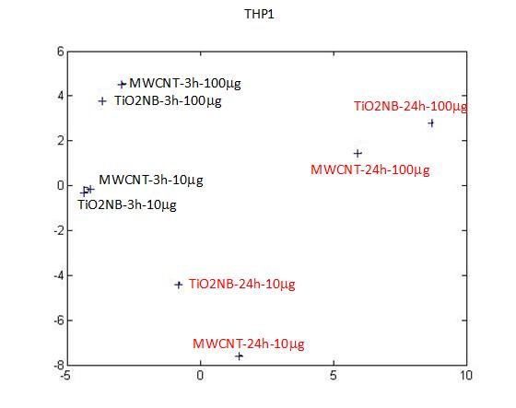
PCA: Short term and long term TiO2 and MWCNT treatment of THP1 cells

Slide 55
Nano publications
1) Basak, S.C.; Vracko, M.; Witzmann, F.A. Mathematical nanotoxicoproteomics: Quantitative characterization of effects of multi-walled carbon nanotubes (MWCNT) and TiO2 nanobelts (TiO2-NB) on protein expression patterns in human intestinal cells. Curr. Comput. Aided Drug Des., 2016,
12(4), 259-264.
2) Basak, S.C.; Vracko, M.; Witzmann, F.A A Possible Chemo-biodescriptor Framework for the Prediction of Toxicity of Nanosubstances: An Integrated Computational Approach, Current Computer-Aided Drug Design, 2017, Vol. 13, 1

Slide 56
DNA/ RNA SEQUENCE DESCRIPTORS

Slide 57
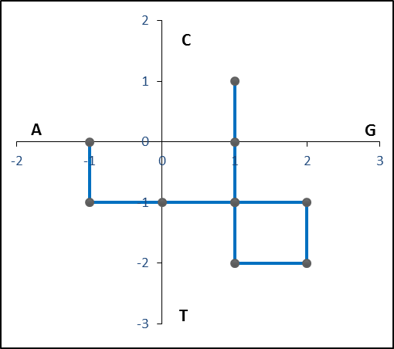
Nandy plot for DNA Sequence: ATGGTGCACC

Slide 58
Base Co-ordinates Center of mass gr
X Y µx µy
A -1 0
T -1 -1
G 0 -1
G 1 -1
T 1 -2 0.7 -0.8 3.3615
G 2 -2
C 2 -1
A 1 -1
C 1 0
C 1 1

Slide 59
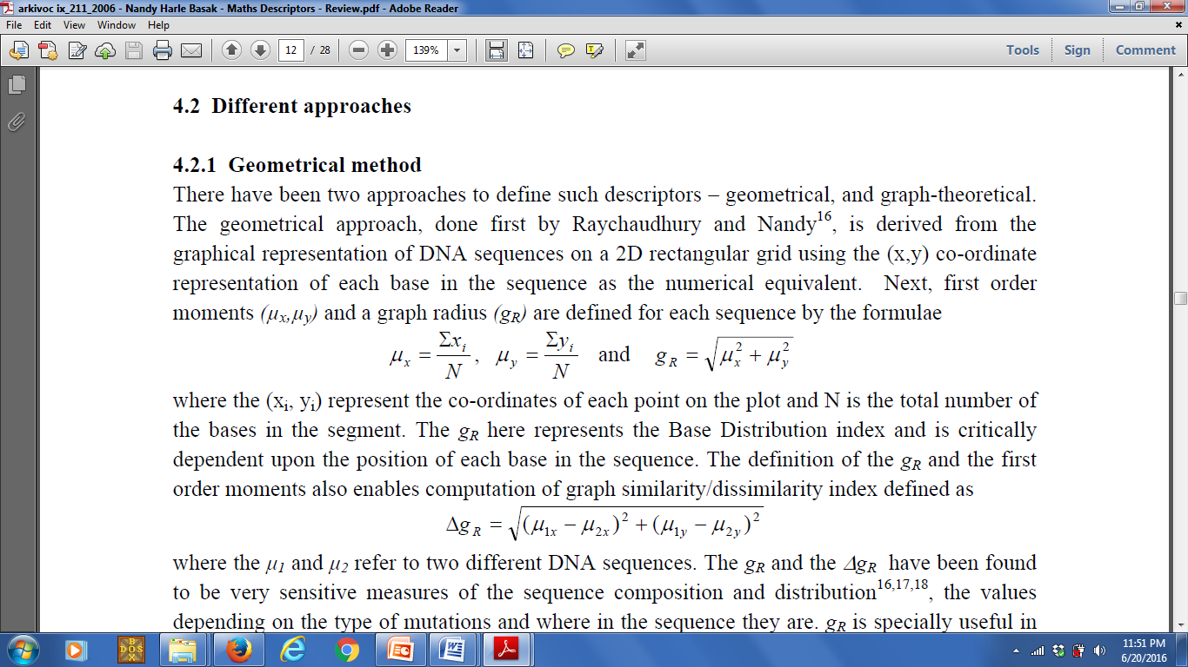
Formulas for Descriptors in 2D Graphical Representations
1. DNA Descriptors

Slide 60
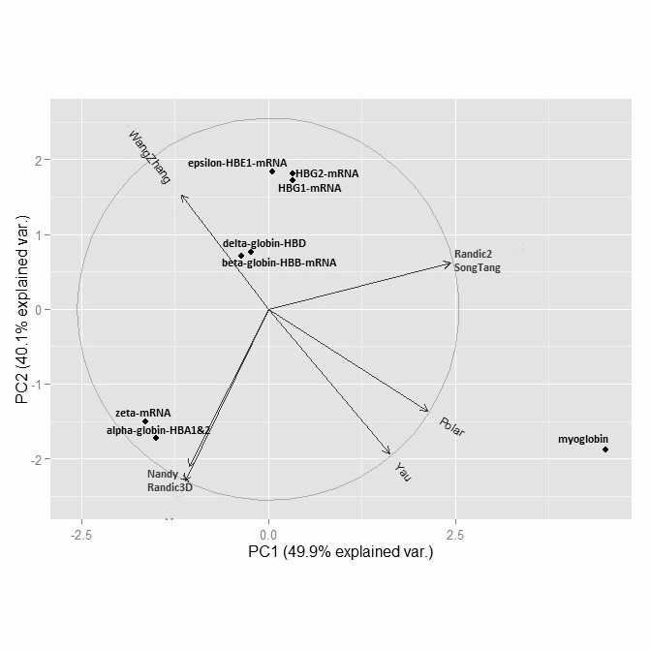
Graphical Abstract for “Intercorrelation of major DNA/RNA sequence descriptors - A preliminary study”
Start with Nucleic Acid Sequences
Calculate 7 types of numerical descriptors
Carry out Intercorrelation and Principal Component analysis of data
Sequence characterization using selected descriptors and PCs.

Slide 61
Table 5: Correlations between different methods for all descriptors of 34 sequences of various globin genes together. Strong correlations are in bold font and underlined.
 | Nandy | Randic3D | Polar Plot | WangZhang | SongTang | Randic2D | Yau
Nandy |  | 0.9574 | 0.7017 | 0.0615 | 0.6804 | 0.6806 | 0.7114
Randic3D |  |  | 0.7776 | 0.0559 | 0.7574 | 0.7576 | 0.7865
Polar Plot |  |  |  | 0.2898 | 0.9995 | 0.9995 | 0.9997
WangZhang |  |  |  |  | 0.2998 | 0.2993 | 0.2835
SongTang |  |  |  |  |  | 1.0000 | 0.9988
Randic2D |  |  |  |  |  |  | 0.9988
Strong correlation between Nandy (2D) and Randic 3D – Note that the three 2D graphs are 2D projections of Randic 3D model
Strong correlation between Yau and Randic 2D is counter-intuitive – Yau model opens wide with increasing bases, Randic 2D runs within parallel lines
Song and Tang and WangZhang are complex and do not correlate well with other models – probably encodes non-redundant information

Slide 62


Slide 63
Integrated QSAR (I-QSAR)
DNA Descriptors
TS
TC
Geo
QC
Gene Expression
Proteomics
Chemoinformatics
Bioinformatics
I-QSAR

Slide 64
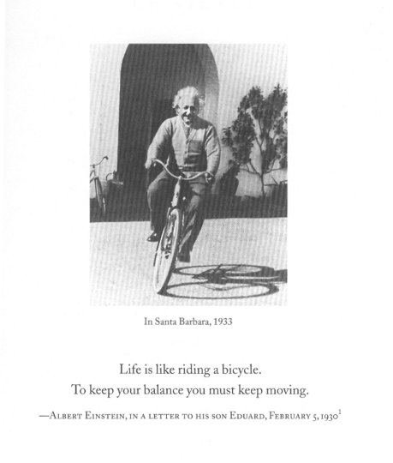

Slide 65
Mulțumesc
অনেক ধন্যবাদ
Thank you very much
CHARAIVETI (चरैवेति)

Slide 66
